Slide 1
Greedy Algorithms
Chaklam Silpasuwanchai

Slide 2
Readings
Chapter 16, Greedy Algorithms, Cormen et al. (2009). Introduction to Algorithms, Third Edition (3rd ed.). The MIT Press.
Douglas Wilhelm Harder, Waterloo University - https://ece.uwaterloo.ca/~dwharder/aads/

Slide 3
Outline
Introduction to Greedy Algorithms
Fractional Knapsack problem
Huffman coding

Slide 4
Greedy Algorithm
For many optimization problems, dynamic programing can be overkill, simpler, more efficient algorithms will do
Greedy algorithms always make the choice that looks best at the moment, i.e., local optima.
Hope that it will reach global optima
Add local optima together does not always yield global optima, but for many problems, they do, for example:
Prim’s algorithm
Kruskal’s algorithm
Dijkstra’s algorithm
But for some problems, they are not optimal:
Traveling salesman

Slide 5
Greedy Algorithm vs. Dynamic Programming
Greedy | Dynamic | Divide and Conquer
Each step, take the greedy choice | Each step, take the choice on the solution to subproblems. These subproblems are dependent | Each step, take the choice on the solution to subproblems. These subproblems are independent
Whatever choice is best at the moment - usually in a top down fashion, reducing larger problem to a smaller one | Bottom-up - from smaller subproblems to larger subproblems. Store the solution to the smaller subproblems. | Top-down, breaking problems into smaller problems

Slide 6
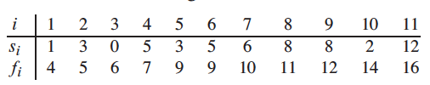
Activity Selection problem
Suppose we have a set S = {a₁, a₂, …., a} of n activities that use a resource, such as auditorium and can only serve one activity at a time
Our goal is to select a maximum size set of compatible activities
Each activity a_{i} has a start time s_{i} and finish time f_{i}
a_{i} and a_{j} are compatible if s_{i} ≥ f_{j} or s_{j} ≥ f_{i}
Here {a₃, a₉, a₁₁} is compatible, so is {a₁, a₄, a₈, a₁₁} and {a₂, a₄, a₉, a₁₁}
The answer for this problem will be the largest set, which are the latter two (size of 4)

Slide 7
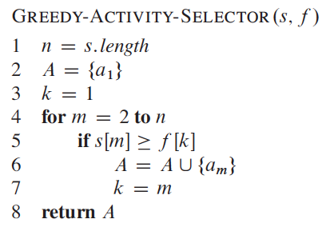
Activity Selection problem
Can use greedy method
Intuitively, we should choose an activity that use as little resource (time) as possible, so we can pick more activities
We can first choose the activity with the earliest finish time, thus it means we need to sort all activity of finishing time from lowest to highest
Then, for the next activity, just select in the sorted order, the starting time which is equal or greater than the previous activity

Slide 8
Making change w/ greedy?
Making the exact change with the minimum number of coins
Consider 1, 2, 5, 10, 20, 50 cents
You need to change for 72 cents
50
20
2
Optimal!
Consider 1, 4, 9, 16, 25, 36, and 49 chakycents
You need to change for 72 chakycents
49
16
4
1
1
1
But optimal solution is ???

Slide 9
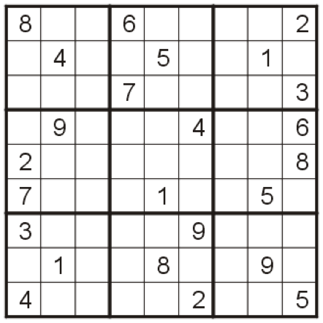
Sudoku w/ greedy?

Slide 10
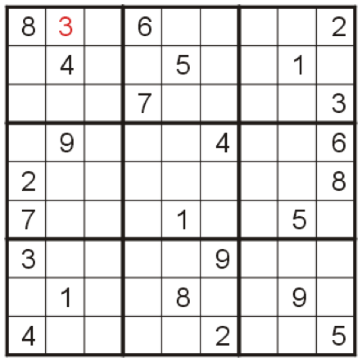
Sudoku w/ greedy?
Neither 1 nor 2 fits into the first empty square, so we fill it with 3

Slide 11
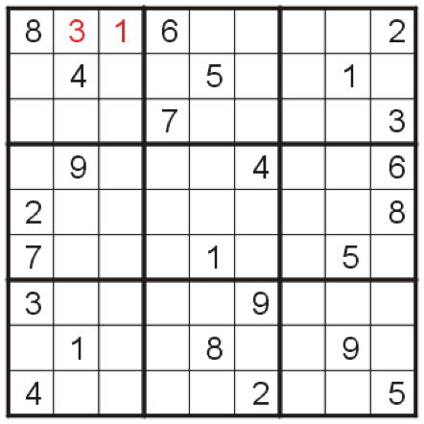
Sudoku w/ greedy?
The second empty square may be filled with 1

Slide 12
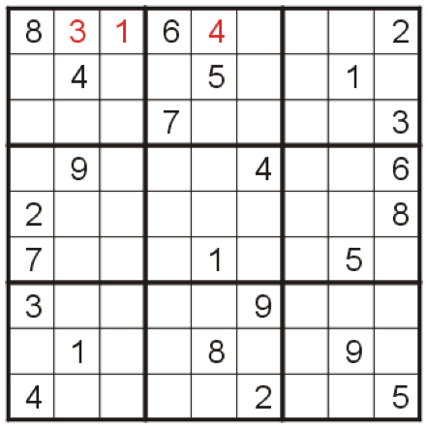
Sudoku w/ greedy?
And the 3rd empty square may be filled with 4

Slide 13
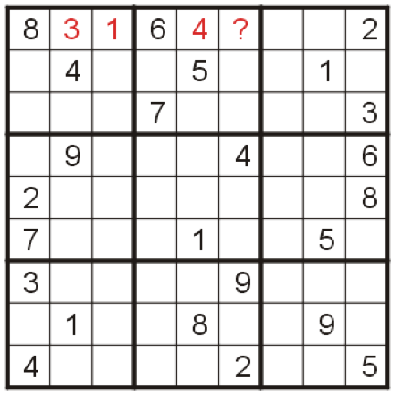
Sudoku w/ greedy?
At this point, we try to fill in the 4th empty square

Slide 14
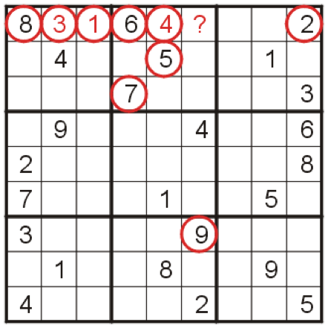
Sudoku w/ greedy?
Unfortunately, all nine numbers 1 – 9 already appear in such a way to block it from appearing in that square

Slide 15
Traveling salesman w/ greedy?
The travelling salesman problem (TSP) asks the following question: "Given a list of cities and the distances between each pair of cities, what is the shortest possible route that visits each city and returns to the origin city?
The nearest neighbor algorithm is greedy:
Choose one node as starting node
Go to the closest unvisited node
Return to the starting node
The algorithm does not always yield optimal results

Slide 16
Traveling salesman w/ greedy?
Greedy method: A->B->C->D->A = 60
But the optimal is: A->B->D->C->A = 52
A
13
13
24
B
C
10
13
D
13

Slide 17
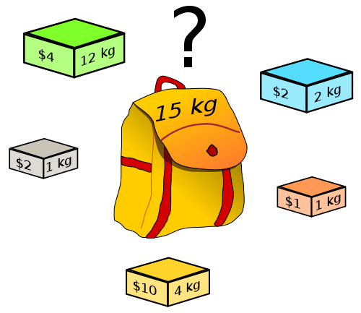
Knapsack problem
Given a set of items, each with a weight and a value, determine the number of each item to include in a collection so that the total weight is less than or equal to a given limit and the total value is as large as possible

Slide 18
Let’s use greedy method
Object | 1 | 2 | 3 | 4 | 5 | 6 | 7
Value | 10 | 5 | 15 | 7 | 6 | 18 | 3
Weight | 2 | 3 | 5 | 7 | 1 | 4 | 1
n = 7
m = 15
How to maximize bag value with limited weight of 15?
We may use best value per weight

Slide 19
Fractional Knapsack problem
Object | 1 | 2 | 3 | 4 | 5 | 6 | 7
Value | 10 | 5 | 15 | 7 | 6 | 18 | 3
Weight | 2 | 3 | 5 | 7 | 1 | 4 | 1
Value/ Weight | 5 | 1.66 | 3 | 1 | 6 | 4.5 | 3
How much? | 1 | 2/3 | 1 | 0 | 1 | 1 | 1
Now, simply takes the biggest one in order
Value = Obj 5 (6) + Obj 1 (10) + Obj 6 (18) + Obj 3 (15) + Obj 7 (3) + Obj 2 (⅔ * 5) = 55.33
Weights = Obj 5 (1) + Obj 1 (2) + Obj 6 (4) + Obj 3 (5) + Obj 7 (1) + Obj 2 (2) = 15

Slide 20
Limitation
To apply greedy algorithm, we have to assume “fractional” knapsack problem.
That is, each item can be subdivided, e.g., potatoes, vegetables.
If we are interested in 0/1 knapsack problem, we have to look at dynamic programming

Slide 21
Huffman Coding Problem
Given any data, how to compress it?
Compression has many obvious benefits, reducing the cost of transmission

Slide 22
General approach
First, let’s see what is the cost of transmission without compression
Length = 20
Message has to be send using ASCII code (8-bit)
For example A = 65 which is 01000001
So the total is 160
Can be compress this further?
Message = BCCABBDDAECCBBAEDDCC

Slide 23
General approach
Message = BCCABBDDAECCBBAEDDCC
Character | Count/frequency | Code
A | 3
B | 5
C | 6
D | 4
E | 2

Slide 24
General approach
Message = BCCABBDDAECCBBAEDDCC
Character | Count/frequency | Code
A | 3 | 000
B | 5 | 001
C | 6 | 010
D | 4 | 011
E | 2 | 100

Slide 25
General approach
Using this way, I need only 20 x 3 = 60 bits
Message = BCCABBDDAECCBBAEDDCC
Character | Count/frequency | Code
A | 3 | 000
B | 5 | 001
C | 6 | 010
D | 4 | 011
E | 2 | 100

Slide 26
General approach
But now the problem is….
If I send the file, how the receiver know my code?
Also, how can I, the sender, remember my code?
Yes, I need to maintain a reference table
How big is this table?
Has two columns (characters and code)
characters (5 characters x 8 bits) + code (5 characters x 3 bits) = 55
So now the total size of the message is
60 bits + 55 bits = 115 bits
Now….the question is, can we further optimize the coding process so the size is smaller?

Slide 27
Huffman Coding
Message = BCCABBDDAECCBBAEDDCC
Step 1: Arrange char in increasing order of freq.
Char | Count | Code
A | 3
B | 5
C | 6
D | 4
E | 2
2 | 3 | 4 | 5 | 6
E | A | D | B | C

Slide 28
Huffman Coding
Message = BCCABBDDAECCBBAEDDCC
Step 2: Choose two smallest and merge
Char | Count | Code
A | 3
B | 5
C | 6
D | 4
E | 2
5
2 | 3 | 4 | 5 | 6
E | A | D | B | C

Slide 29
Huffman Coding
Message = BCCABBDDAECCBBAEDDCC
Repeat 2 until all done
9
Char | Count | Code
A | 3
B | 5
C | 6
D | 4
E | 2
5
2 | 3 | 4 | 5 | 6
E | A | D | B | C

Slide 30
Huffman Coding
Message = BCCABBDDAECCBBAEDDCC
Repeat 2 until all done
9
Char | Count | Code
A | 3
B | 5
C | 6
D | 4
E | 2
5
11
2 | 3 | 4 | 5 | 6
E | A | D | B | C

Slide 31
Huffman Coding
Message = BCCABBDDAECCBBAEDDCC
Repeat 2 until all done
20
9
Char | Count | Code
A | 3
B | 5
C | 6
D | 4
E | 2
5
11
2 | 3 | 4 | 5 | 6
E | A | D | B | C

Slide 32
Huffman Coding
Message = BCCABBDDAECCBBAEDDCC
Step 3: mark all left side 0 and all right side 1
0
20
9
1
Char | Count | Code
A | 3
B | 5
C | 6
D | 4
E | 2
0
5
1
11
1
0
1
0
2 | 3 | 4 | 5 | 6
E | A | D | B | C

Slide 33
Huffman Coding
Message = BCCABBDDAECCBBAEDDCC
Step 4: Follow the path from top and write the code
0
20
9
1
Char | Count | Code
A | 3 | 001
B | 5 | 10
C | 6 | 11
D | 4 | 01
E | 2 | 000
0
5
1
11
1
0
1
0
2 | 3 | 4 | 5 | 6
E | A | D | B | C

Slide 34
Huffman Coding
Message = BCCABBDDAECCBBAEDDCC
Step 4: Follow the path from top and write the code
Char | Count | Code | Message Bits | Ref Table Bits
A | 3 | 001 | 9
B | 5 | 10 | 10
C | 6 | 11 | 12
D | 4 | 01 | 8
E | 2 | 000 | 6
 |  | Tot: | 45
0
20
9
1
0
5
1
11
1
0
1
0
2 | 3 | 4 | 5 | 6
E | A | D | B | C

Slide 35
Huffman Coding
Message = BCCABBDDAECCBBAEDDCC
Step 4: Follow the path from top and write the code
Char | Count | Code | Message Bits | Ref Table Bits
A | 3 | 001 | 9 | 11
B | 5 | 10 | 10 | 10
C | 6 | 11 | 12 | 10
D | 4 | 01 | 8 | 10
E | 2 | 000 | 6 | 11
 |  | Tot: | 45 | 52
0
20
9
1
0
5
1
11
1
0
1
0
2 | 3 | 4 | 5 | 6
E | A | D | B | C

